Slide 1
An overview of berkshire hathaway
Yuchen lu

Slide 2
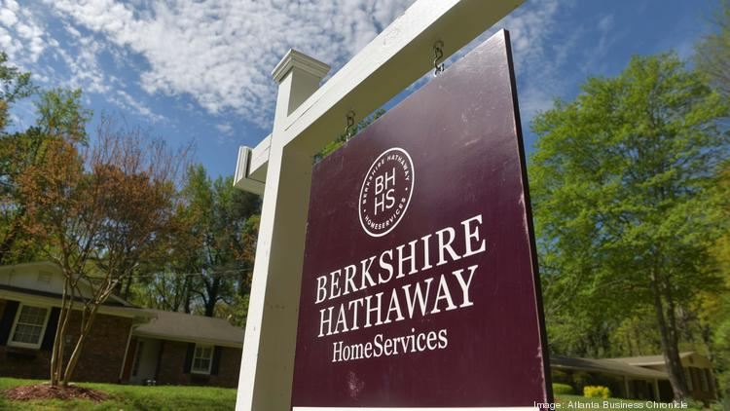

Motivation & goals

Slide 3
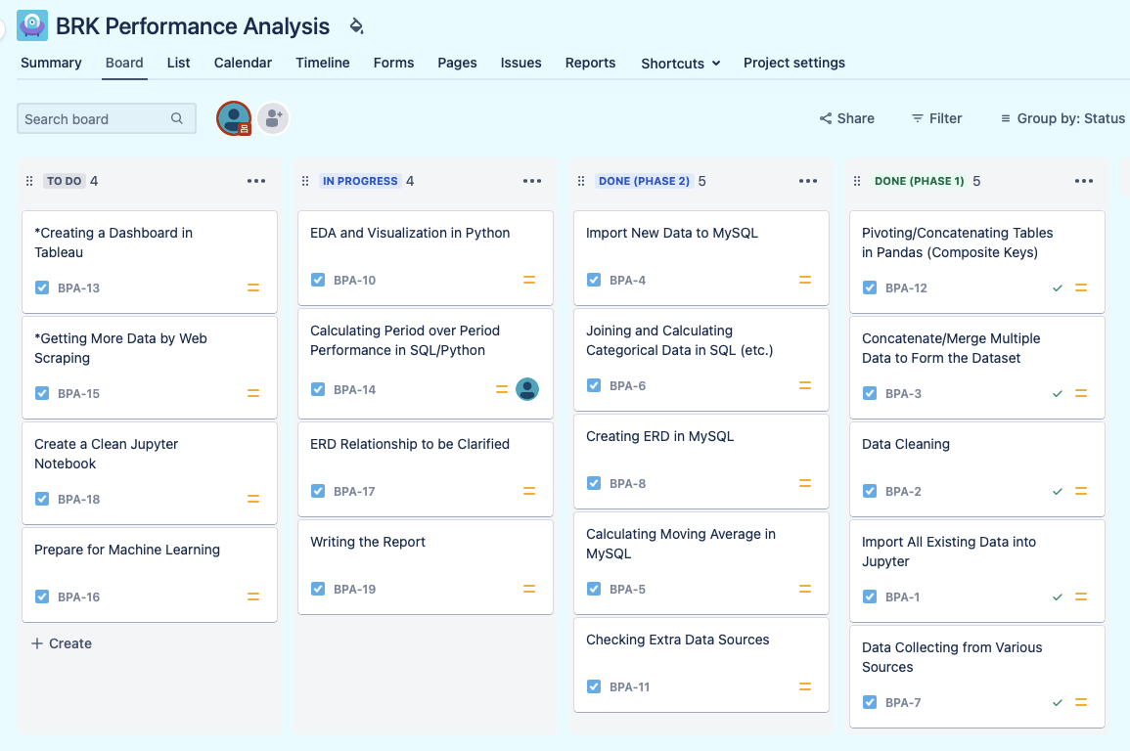
Planning

Slide 4
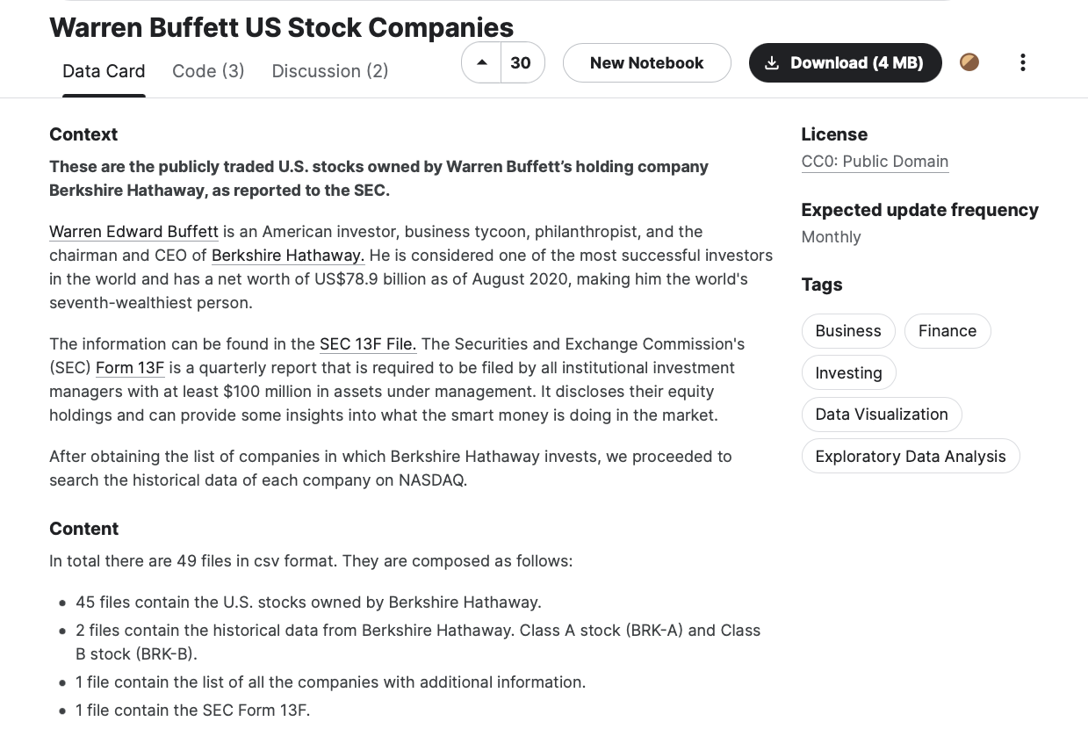
Data sources (1)

Slide 5
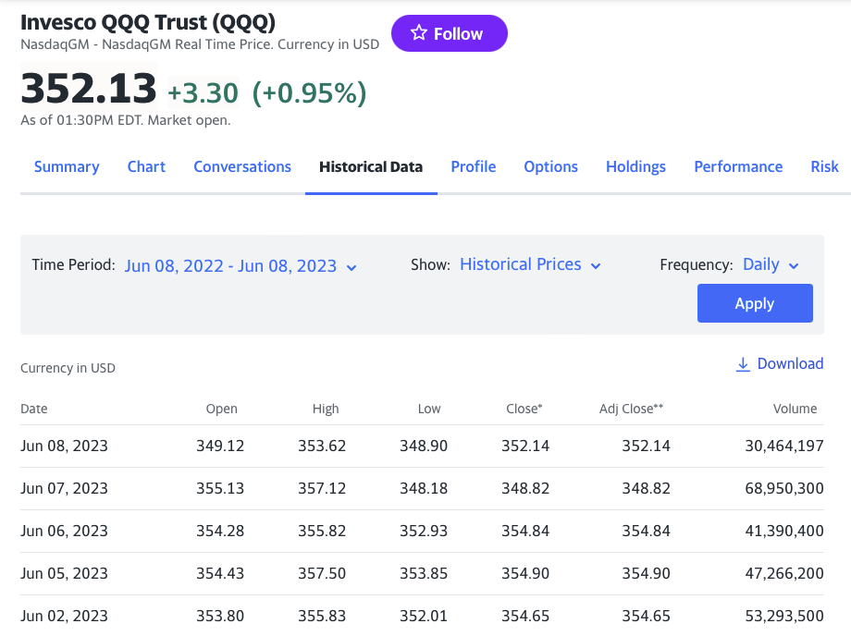
Data sources (2)

Slide 6
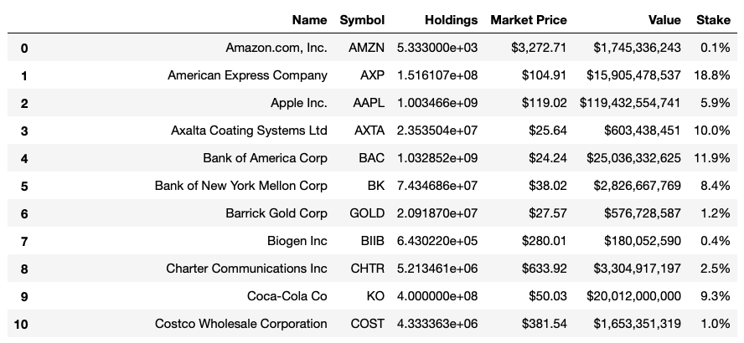
Data cleaning
Task II : Imputing the missing values.
Task I : Removing unnecessary symbols and then change the type of the values

Slide 7
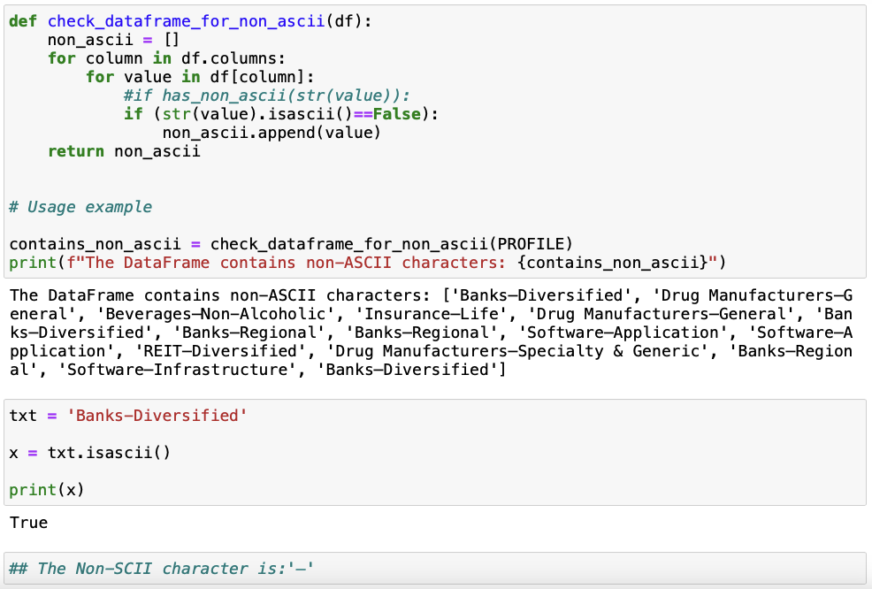
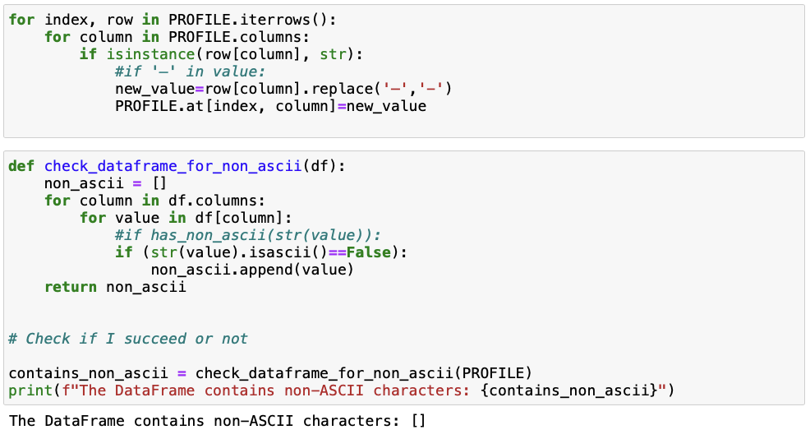
Task III : Changing the hidden non-SCII characters

Slide 8
Metadata shift
What is the best way to concatenate/merge the stock files of 45 companies ?
Solution One : Merge Horizontally
→ A Dataframe with 3498 rows and 271 columns
Advantage : Unified “Date” column; ready to be exploited for Machine Learning
Disadvantage : ?

Slide 9
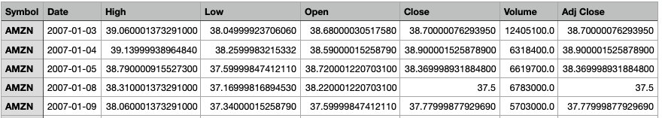
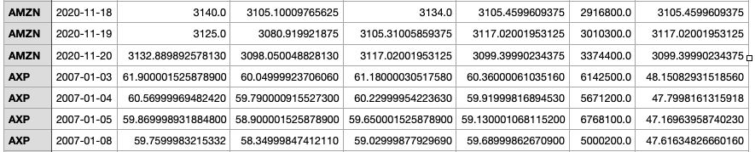
~~Later, it turned out that the REAL challenge is to create a proper ERD
Solution Two : Pivot and Concatenate vertically
→ A Dataframe with 129590 rows and 8 columns
“Symbol” becomes the common key; “Symbol” + “Date” constitute a composite key

Slide 10
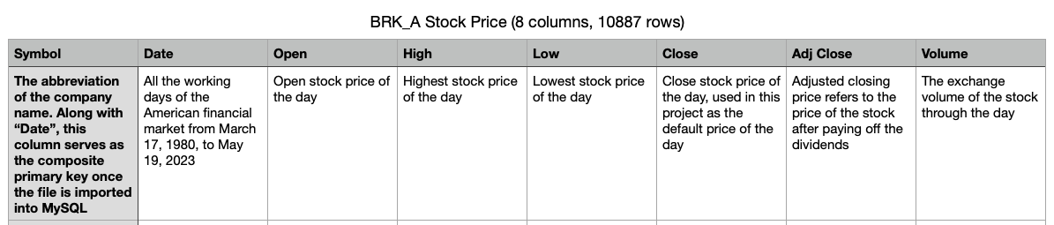
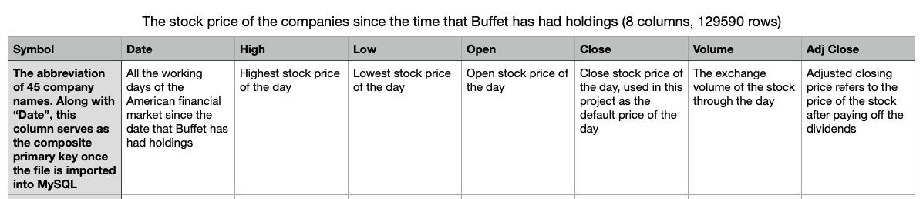
Cleaned dataset

Slide 11
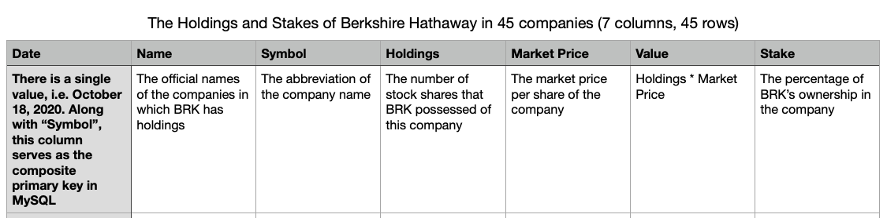
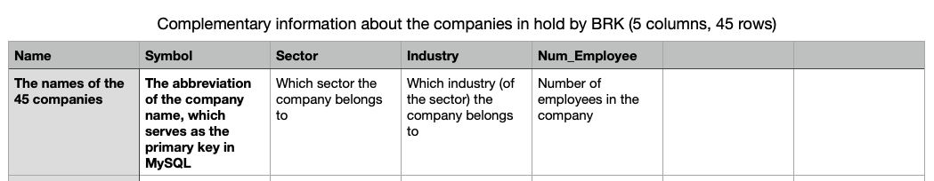
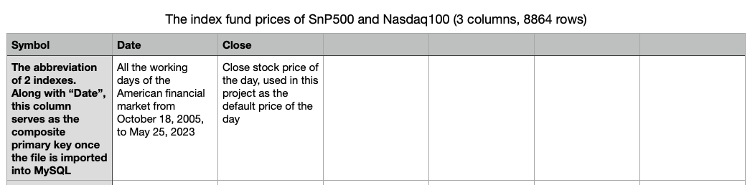

Slide 12
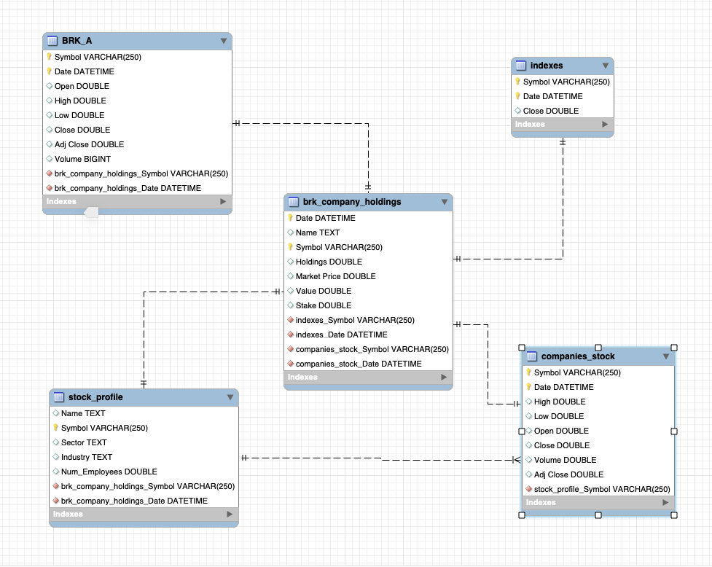
erd

Slide 13
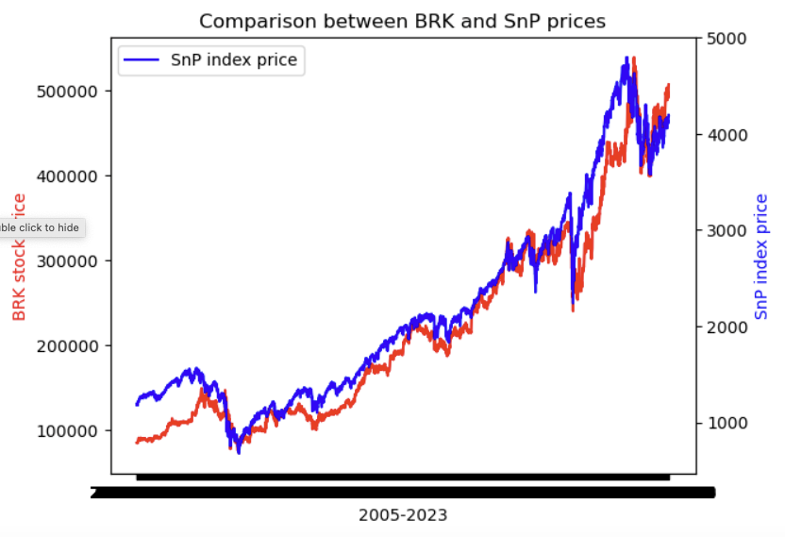
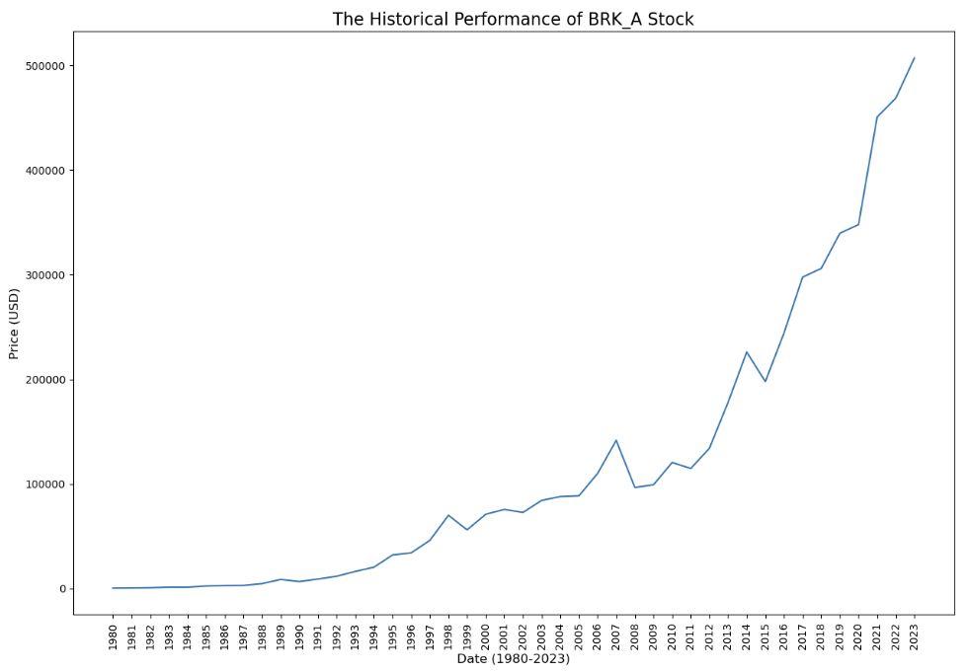
Eda[1] – Line charts
Slightly better than SnP500
Similar long-term trends
Monetary easing cycle (2012-2021)

Slide 14
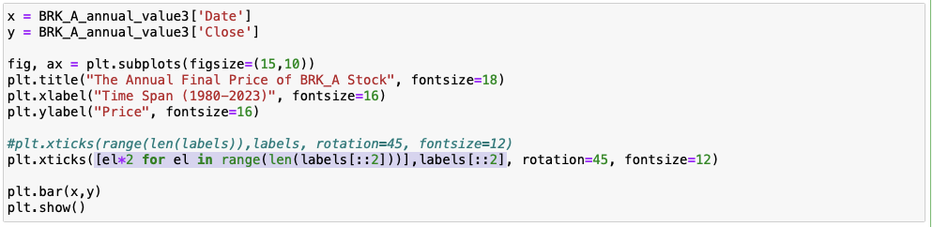
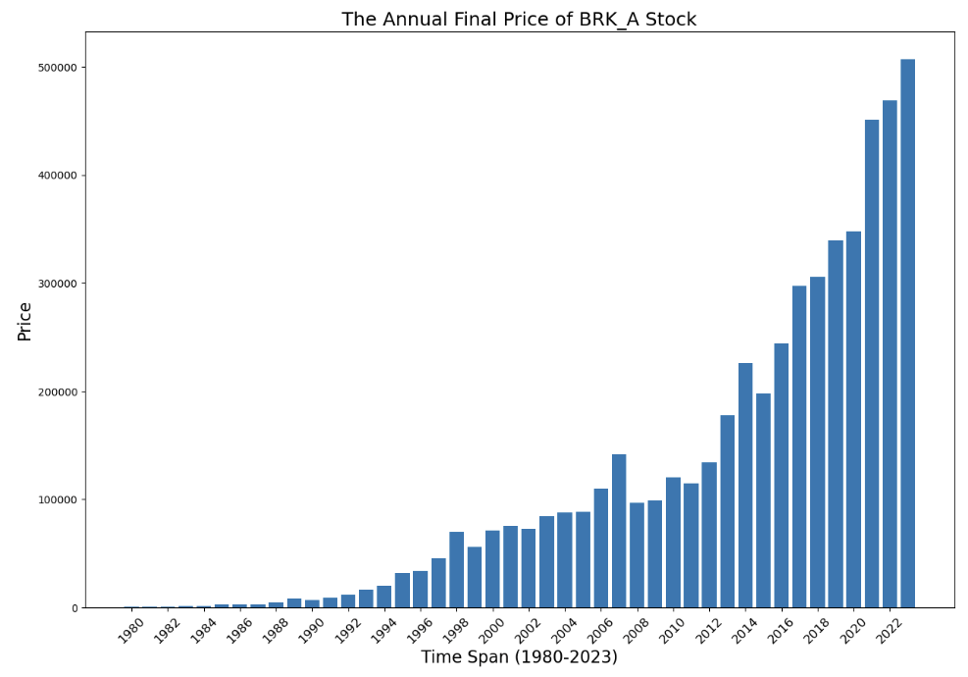
Eda[2] – bar chart

Slide 15
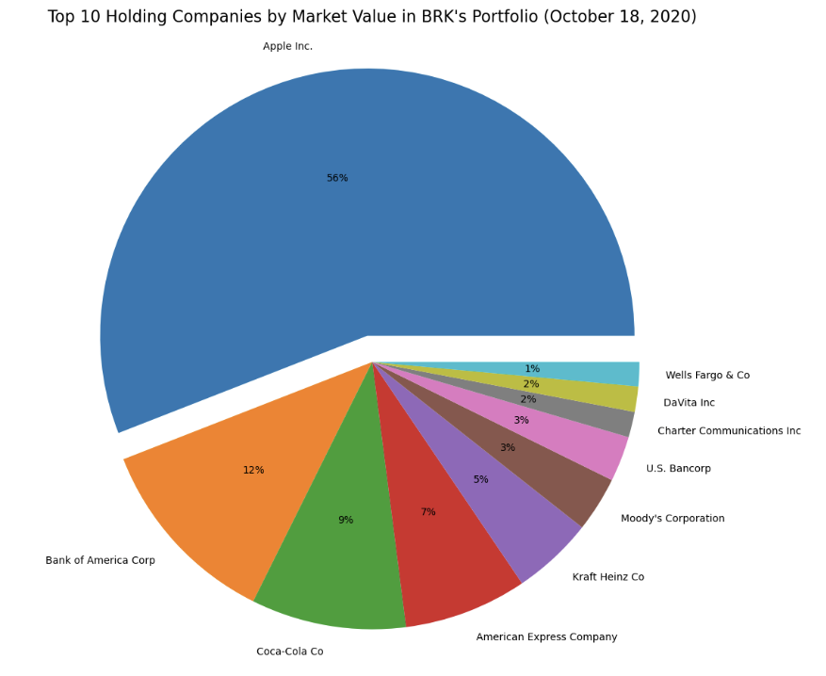
Eda[3] – Pie plot
Heavily invested in Apple (ref. Amazon, Snowflake)
Having Diversified investment in various sectors : technology, finance, consumer defensive, communication services, health care, etc.

Slide 16
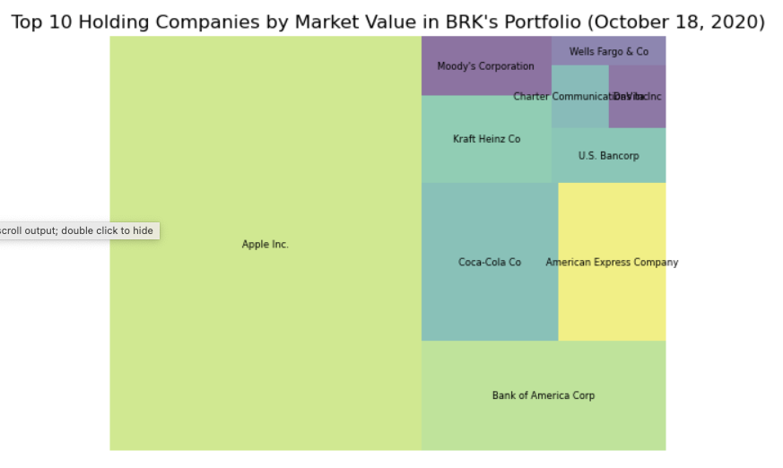
Eda[4] – treemap

Slide 17
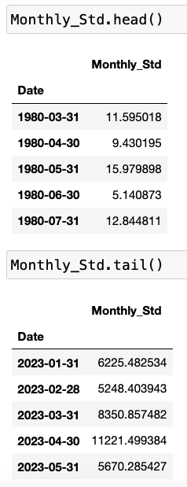
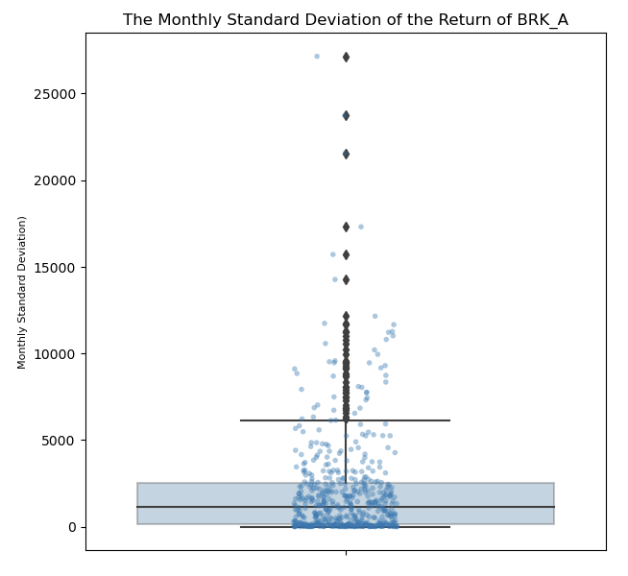
Eda[5] – box plot

Slide 18
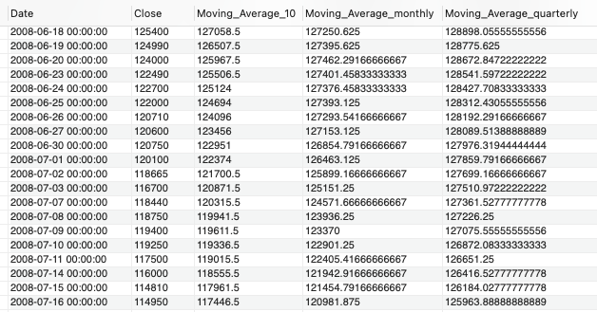
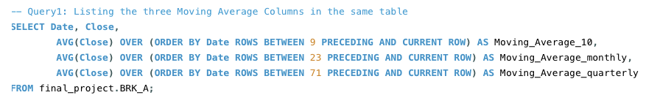
Sql queries (1)

Slide 19
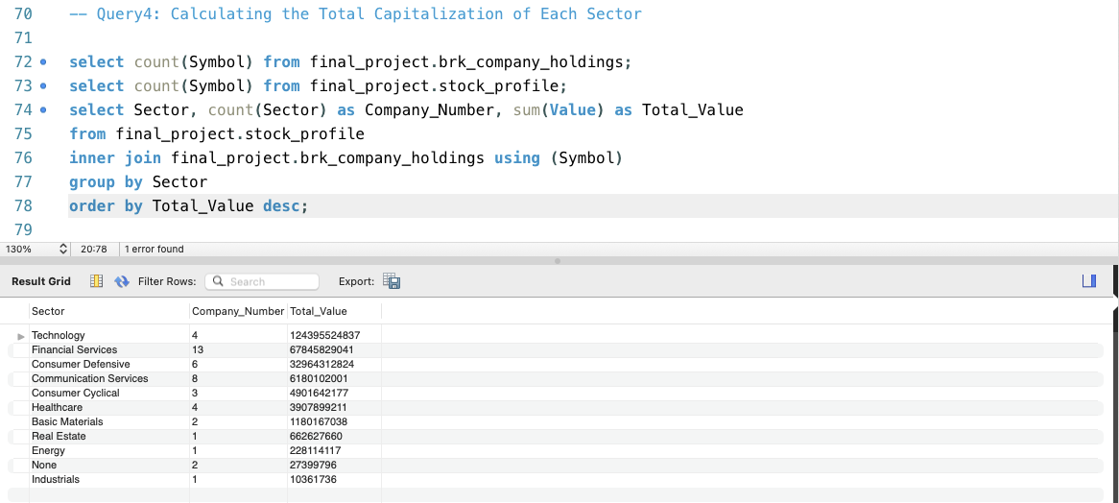
Sql queries (2)
The total investment of Buffet in each sector (desc) corresponds to the conclusions we have drawn from the Pie Plot

Slide 20
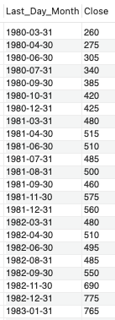
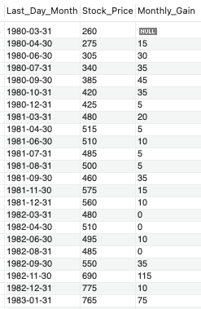
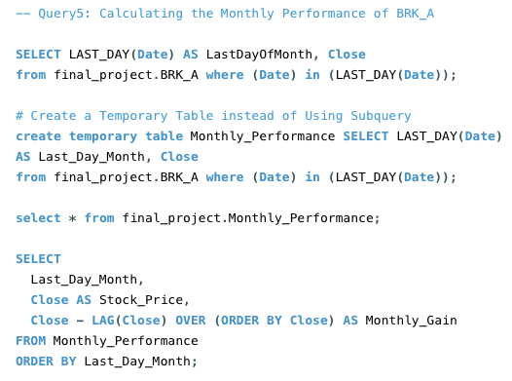
Sql queries (3)

Slide 21
Machine learning
Approach I : Exploiting the company’s stock price data in the past
The model I planned to apply → Long Short Term Memory Network (LSTM) are a type of Recurrent Neural Network for learning long-term dependencies. It is commonly used for processing and predicting time-series data.
* Problem : install tensorflow

Slide 22
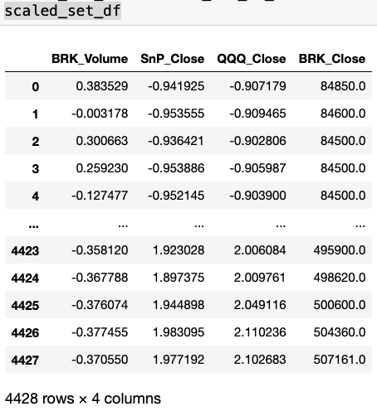
Approach II :
Exploiting external features
Model used → Linear Regression
Normalizing the Dataset by StandardScaler

Slide 23
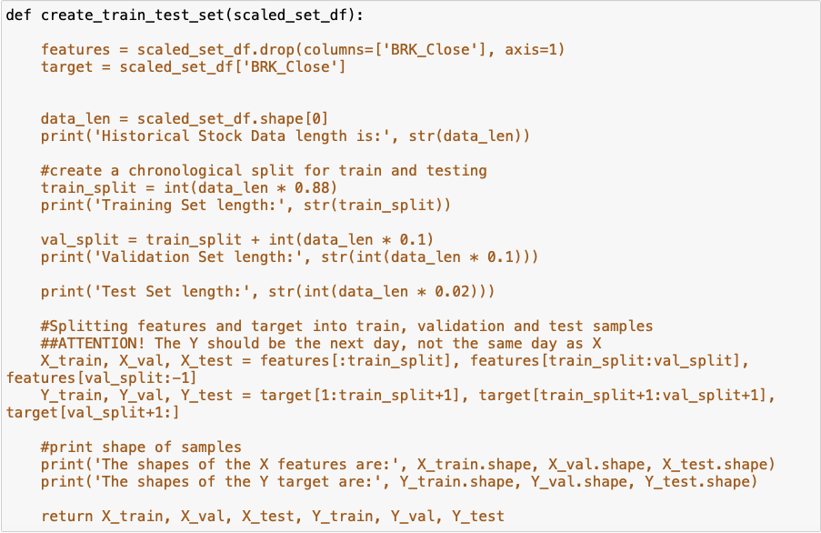
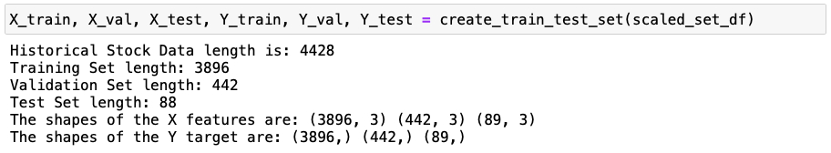
Train, Validation, Test Set

Slide 24
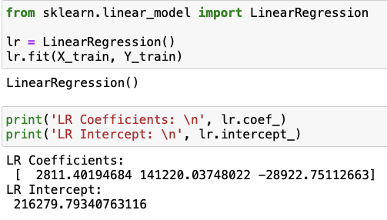
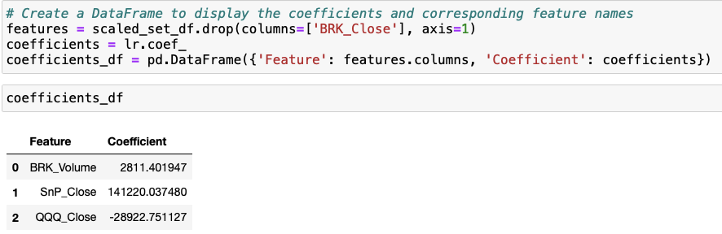
Applying linear regression

Slide 25
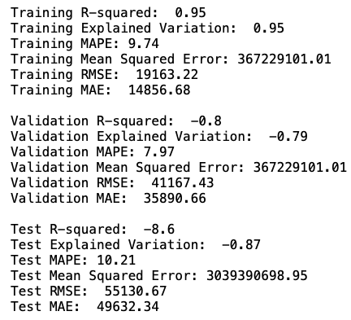
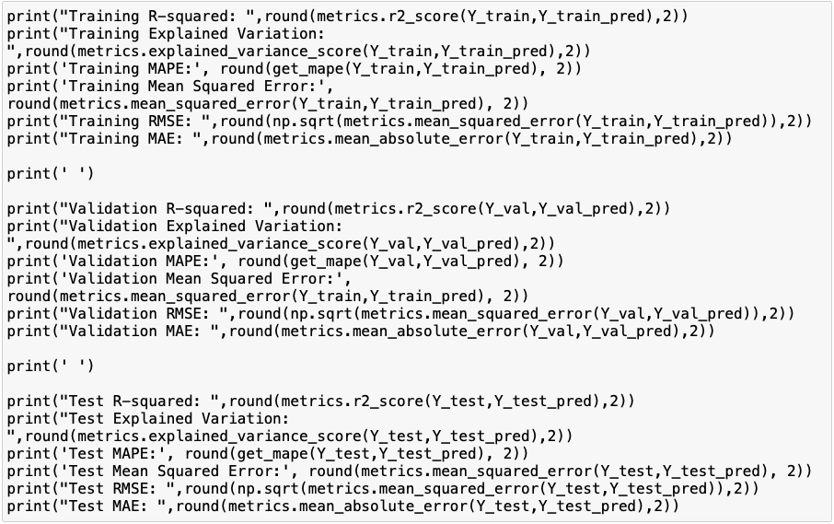
evaluation

Slide 26
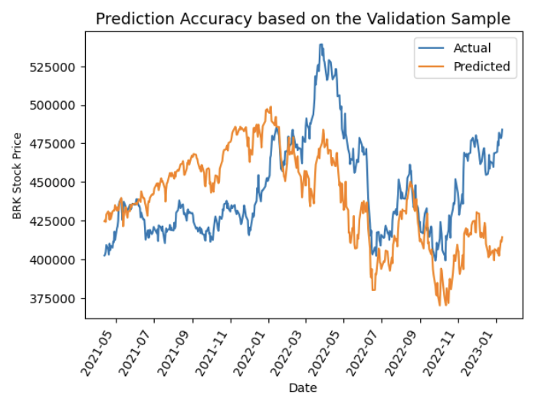
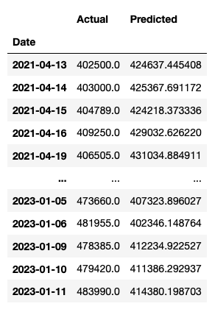
Accuracy (y_val_pred)

Slide 27
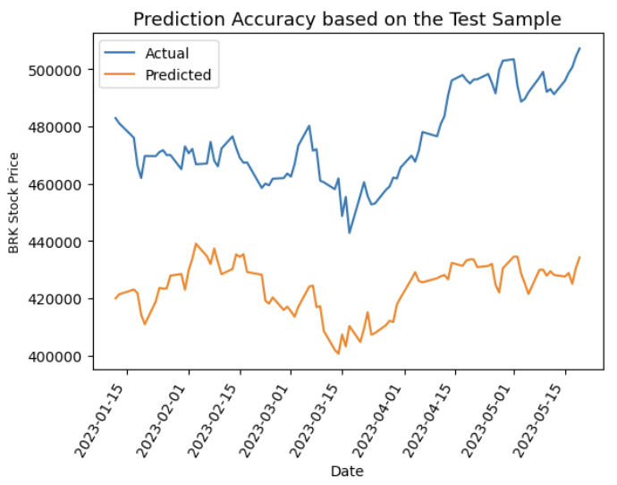
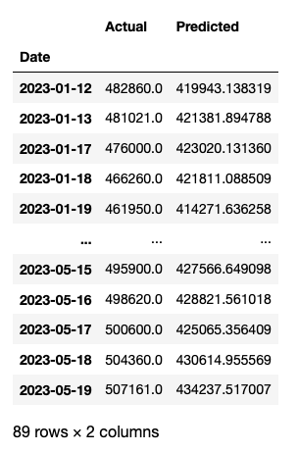
Accuracy (y_test_pred)

Slide 28
Predicting the price in 10/30 days

Slide 29
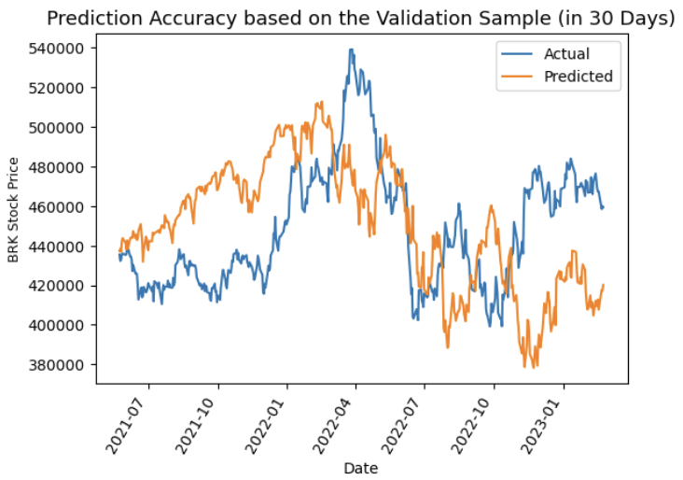
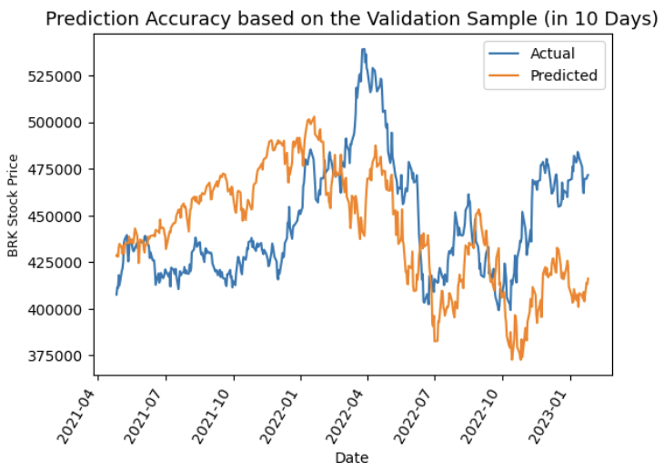
Comparison : Accuracy (y_val_pred)

Slide 30
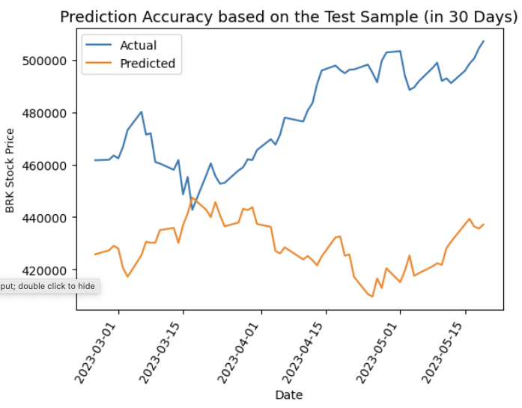
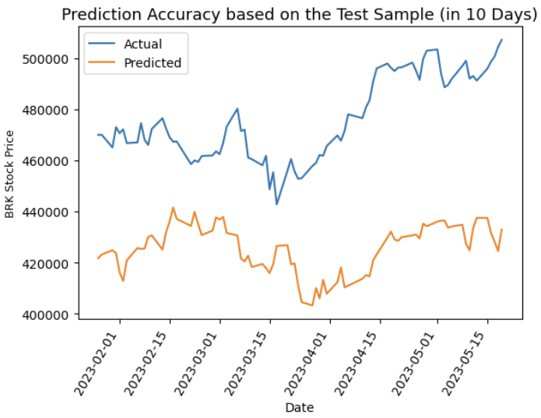
Comparison : Accuracy (y_test_pred)

Slide 31
Reviewing r-squared
Training R-squared : 0.95
Validation R-squared : -0.8
Test R-squared : -8.6

Slide 32
Regrets & hilights
Regret No. 1 : Lack of time to do more visualization in Tableau
Highlight No 1 : Algorithmic Day trading

Slide 33
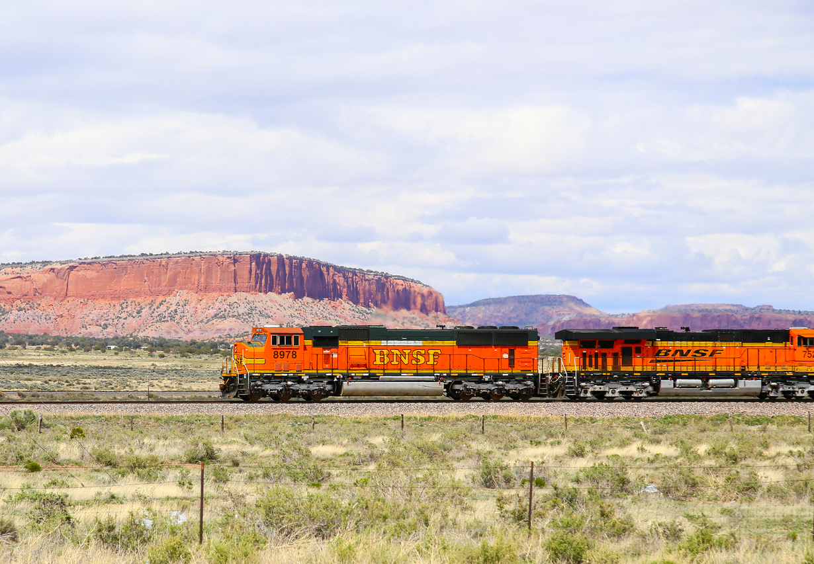
Thank You for Your Attention !

